Slide 1


FLYING TIGER V1.2
Requirement Specification
November 12th, 2014

Slide 2
Changes
There are 3 main changes: 2 new functions + 1 enhancement
Auto loop frames function
Share Twitter function
iPad comparative

Slide 3





1. Auto loop frames function
There are 3 markers: Heart, Rain deer, and Santa
Each marker corresponds to four frames. (total 12 frames as shown below and in slides 4)
In every 1 second frame changes to the next one, and loop continuously
Santa Marker
Santa Marker
S1
S2
S3
S4
S1
S2
S3
S4

Slide 4










Requirement Specification
November 12th, 2014
Heart Marker
H1
H2
H3
H4
Rain deer Marker
R1
R2
R3
R4

Slide 5
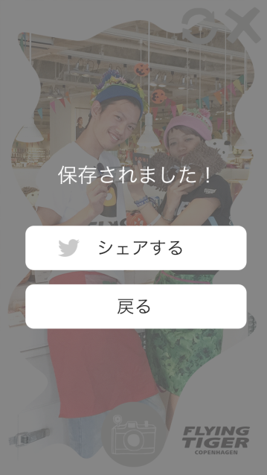
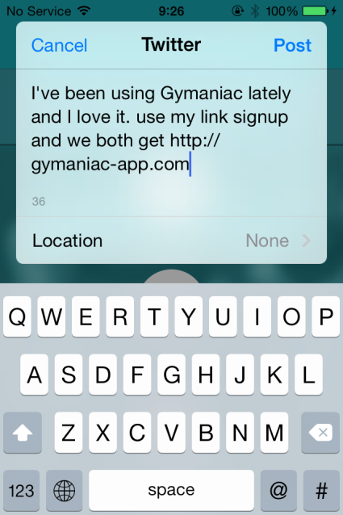
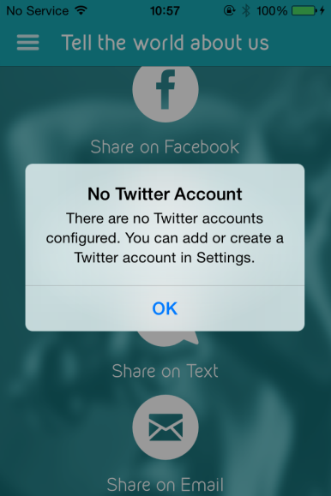
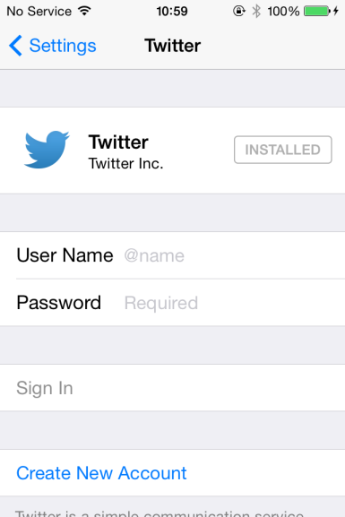
2. Share Twitter function
Flow: After taking picture with frames > Share Screen appears > Choose Share:
If the Twitter account Logged in already from Setting > Pop-up Twitter app with Photo attached. And user can insert comment + choose location (as in Mockup TW picture) > Post
If the app not yet allowed Twitter access or in the first time sharing > Alert appears (as Alert picture) > User has to Go to Setting > Twitter > Login with their Account & Password > Then can go back to Flying Tiger App for continue Sharing
Note: We can set a default message in Status box of Twitter. Do you want to use? If yes, please send me the message.
Share Screen
Mockup TW
Alert Screen
Login TW

Slide 6
3. iPad comparative
The app will appear comparatively in all iPad devices, running iOS 7+ and latest.
Note: Because there is no design of main app screens (Home, Camera, About) for iPad sizes => Apper team will make the demo, using the design for iPhone. And wait for approval of Client.

